Slide 1
Machine Learning Algorithms
Master in Artificial Intelligence
Luís Ferreira
lufer@ipca.pt

Slide 2
Overview
Part I
Artificial Intelligence and Machine Learning
Foundations
Part II
Machine Learning
Part III
Machine Learning Algorithms
Parte IV
Deep Learning & Neural Networks
Parte V
Building a ML Model

Slide 3
Part III
Machine Learning Algorithms
Competencies to be acquired:
EXplainable Artificial Intelligence (XAI)
Explaining Machine Learning Algorithms (XMLA)

Slide 4
Part III: MLA
XAI
White-Box versus Black-Box models
Explore…read about it!
Notes:
https://www.markovml.com/blog/model-interpreting

Slide 5
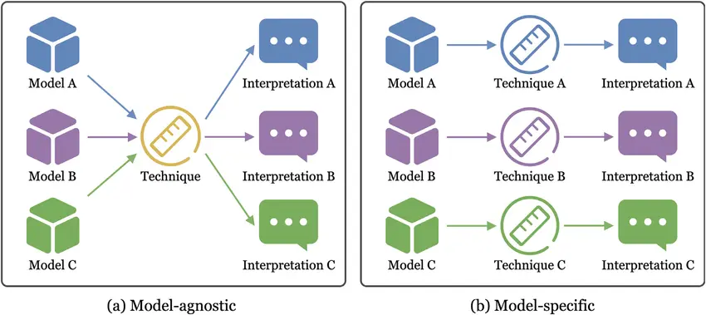
Part III: MLA
XAI
Model Agnostic Explainer
Notes:
https://www.markovml.com/blog/model-interpreting

Slide 6
Part III: MLA
XAI
Explaining
Why
What
When
Who
How
Where
Notes:
https://www.markovml.com/blog/model-interpreting

Slide 7
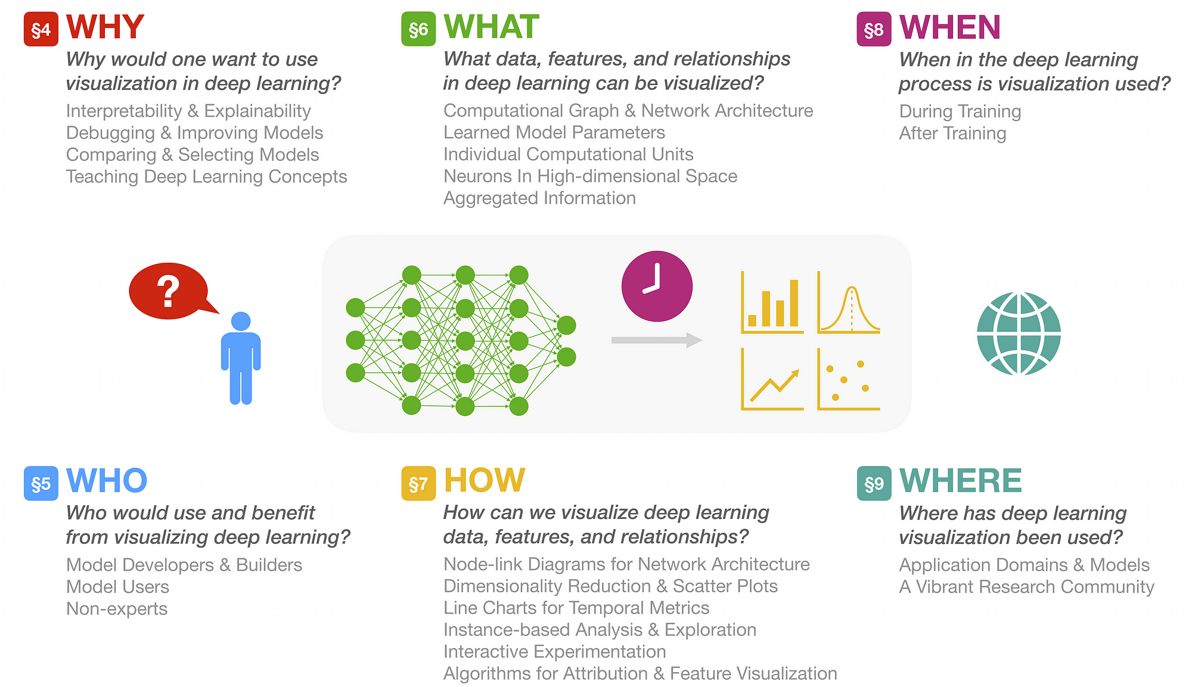
Part III: MLA
XAI
https://www.markovml.com/blog/model-interpreting
Notes:
https://www.markovml.com/blog/model-interpreting

Slide 8
Part I - AI&ML: eXplainable AI
Techniques for Interpreting and Explaining ML Models
  https://www.markovml.com/blog/model-interpreting
Strategies for Debugging Machine Learning Models
  https://www.markovml.com/blog/ml-model-debugging

Slide 9
Progress
Part I
Artificial Intelligence and Machine Learning
Foundations
Part II
Machine Learning
Part III
Machine Learning Algorithms
Part IV
Deep Learning & Neural Networks
Part V
Parte V
Building ML Model

Slide 10
References
Machine Learning. Tom M. Mitchel, McGraw-Hill, 1997
Machine Learning for Everyone
  https://vas3k.com/blog/machine_learning/
Machine Learning Tutorial
  https://www.simplilearn.com/tutorials/machine-learning-tutorial/machine-learning-steps
What is machine learning and how does it work? In-depth guide
  https://www.techtarget.com/searchenterpriseai/definition/machine-learning-ML

Slide 11
References
Google Colab
  https://colab.research.google.com/
Examples of Machine Learning Projects
  https://www.datacamp.com/blog/machine-learning-projects-for-all-levels
Elements of AI (free online course)
  https://www.elementsofai.com/

Slide 12
References

Slide 13
Appendices

